Slide 1


Slide 2
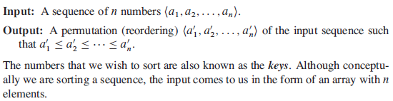
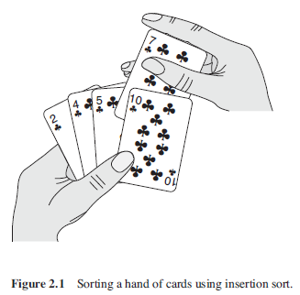
Insertion sort (1)

Slide 3
Insertion sort (2)
Pseudocode for insertion sort as a procedure called INSERTIONSORT, which takes as a parameter an array A[1…n] containing a sequence of length n that is to be sorted.
The algorithm sorts the input numbers in place: it rearranges the numbers within the array A, with at most a constant number of them stored outside the array at any time.
The input array A contains the sorted output sequence when the INSERTION-SORT procedure is finished.

Slide 4
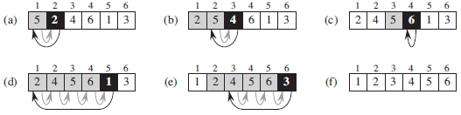
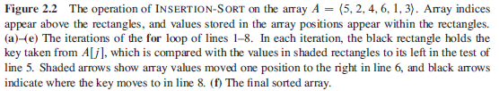
Insertion sort (3)

Slide 5
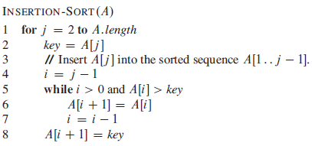
Insertion sort (4)

Slide 6
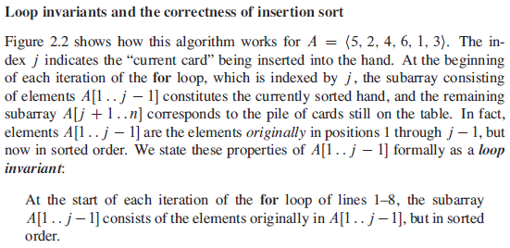
Insertion sort (5)

Slide 7
What is Algorithm Analysis?
How to estimate the time required for an algorithm
Techniques that drastically reduce the running time of an algorithm
A mathemactical framwork that more rigorously describes the running time of an algorithm

Slide 8
Analyzing algorithms(1)
Analysis of insertion sort:
The time taken by the INSERTION-SORT procedure depends on the input: sorting a thousand numbers takes longer than sorting three numbers.
Moreover, INSERTIONSORT can take different amounts of time to sort two input sequences of the same size depending on how nearly sorted they already are.
In general, the time taken by an algorithm grows with the size of the input, so it is traditional to describe the running time of a program as a function of the size of its input.
To do so, we need to define the terms “running time” and “size of input” more carefully.

Slide 9
Analyzing algorithms(2)
The best notion for input size depends on the problem being studied. For many problems, such as sorting or computing discrete Fourier transforms, the most natural measure is the number of items in the input—for example, the array size n for sorting.
For many other problems, such as multiplying two integers, the best measure of input size is the total number of bits needed to represent the input in ordinary binary notation.
Sometimes, it is more appropriate to describe the size of the input with two numbers rather than one. For instance, if the input to an algorithm is a graph, the input size can be described by the numbers of vertices and edges in the graph.

Slide 10
Analyzing algorithms(3)
The running time of an algorithm on a particular input is the number of primitive operations or “steps” executed.
It is convenient to define the notion of step so that it is as machine-independent as possible. For the moment, let us adopt the following view. A constant amount of time is required to execute each line of our pseudocode.
One line may take a different amount of time than another line, but we shall assume that each execution of the i_{th} line takes time c_{i}, where c_{i} is a constant.

Slide 11
Analyzing algorithms(4)
We start by presenting the INSERTION-SORT procedure with the time “cost” of each statement and the number of times each statement is executed.
For each j = 2,3,……,n, where n = A.length, we let t_{j} denote the number of times the while loop test in line 5 is executed for that value of j. When a for or while loop exits in the usual way (i.e., due to the test in the loop header), the test is executed one time more than the loop body.
We assume that comments are not executable statements, and so they take no time.

Slide 12
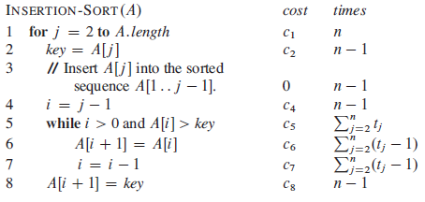
Analyzing algorithms(5)

Slide 13
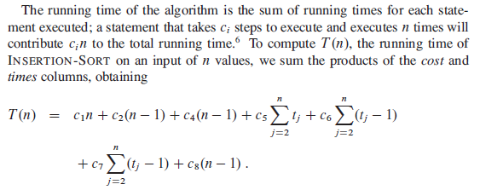
Analyzing algorithms(6)

Slide 14
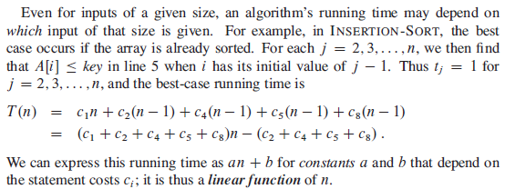
Analyzing algorithms(7)

Slide 15

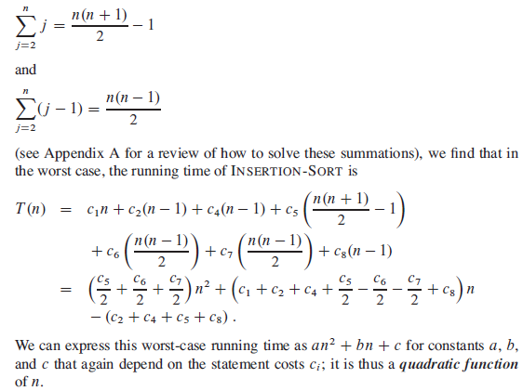

Slide 16
Order of growth
We used some simplifying abstractions to ease our analysis of the INSERTIONSORT procedure.
First, we ignored the actual cost of each statement, using the constants c_{i} to represent these costs.
Then, we observed that even these constants give us more detail than we really need: we expressed the worst-case running time as an² + bn + c for some constants a, b, and c that depend on the statement costs c_{i} . We thus ignored not only the actual statement costs, but also the abstract costs c_{i} .
We shall now make one more simplifying abstraction: it is the rate of growth, or order of growth, of the running time that really interests us.
We therefore consider only the leading term of a formula (e.g., an²), since the lower-order terms are relatively insignificant for large values of n.

Slide 17
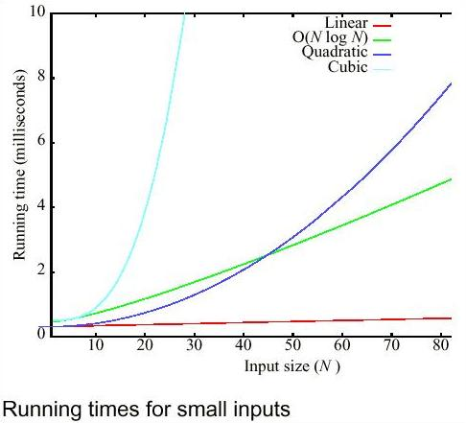
Running time for small inputs

Slide 18
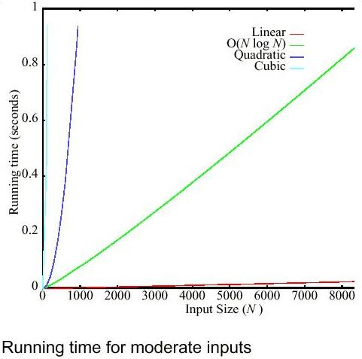
Running time for moderate inputs

Slide 19
Important Question
Is it always important to be on the most preferred curve?
How much better is one curve than another?
How do we decide which curve a particular algorithm lies on?
How do we design algorithms that avoid being on the bad curves?

Slide 20
Algorithm Analysis(1)
Measures the efficiency of an algorithm or its implementation as a program as the input size becomes very large
We evaluate a new algorithm by comparing its performance with that of previous approaches
Comparisons are asymtotic analyses of classes of algorithms
We usually analyze the time required for an algorithm and the space required for a datastructure

Slide 21
Algorithm Analysis (2)
Many criteria affect the running time of an algorithm, including
speed of CPU, bus and peripheral hardware
design think time, programming time and debugging time
language used and coding efficiency of the programmer
quality of input (good, bad or average)

Slide 22
Thank you

